Slide 1
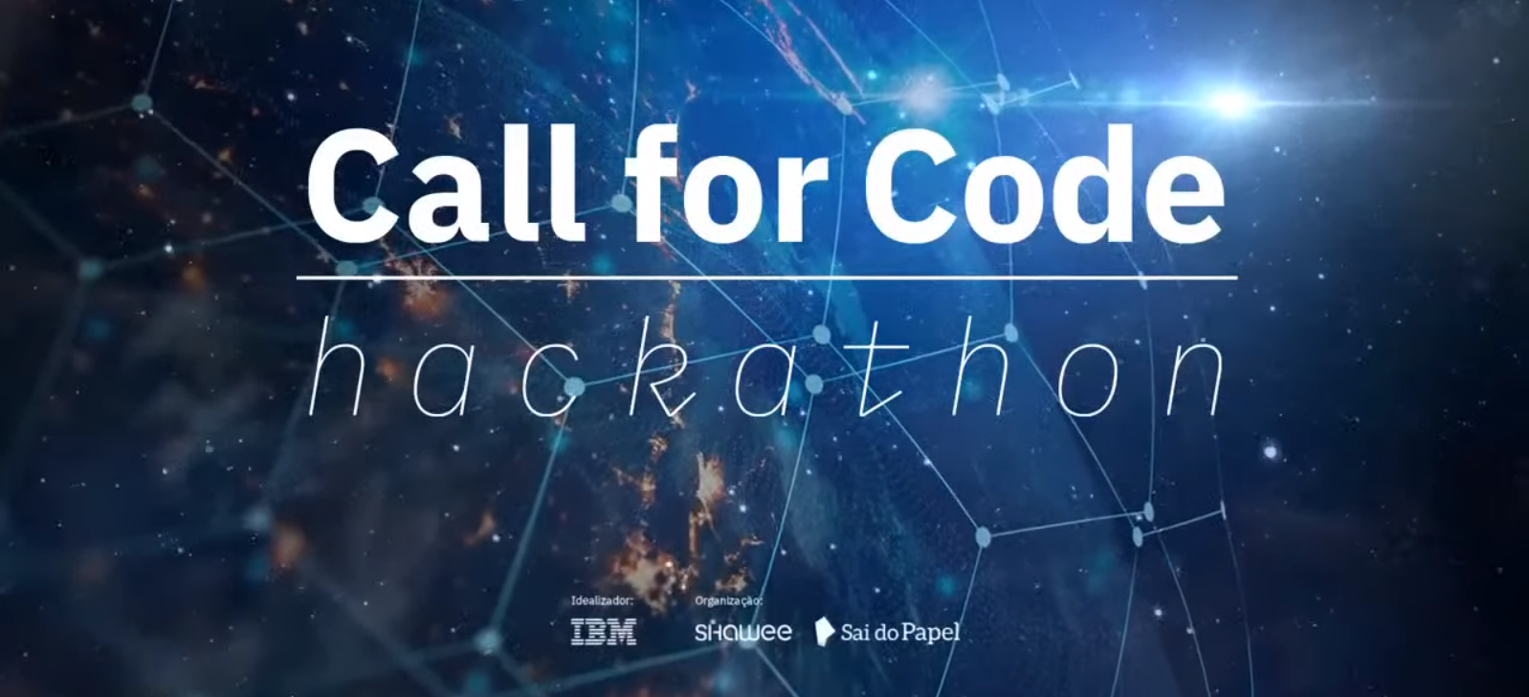
2021-07-30
Clean water and sanitation
forest4water -Nature Based Solutions (NBS) for improving water access and quality -
forest4water@gmail.com

Slide 2
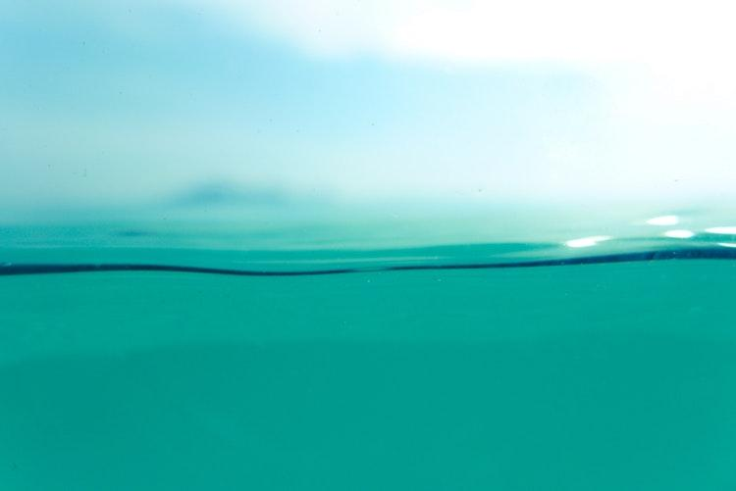
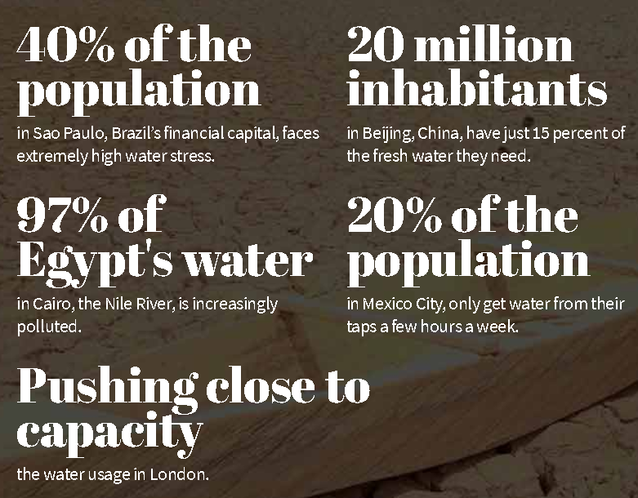
¿Where and who requires water?
gfa.org

Slide 3
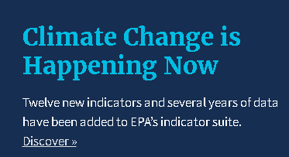
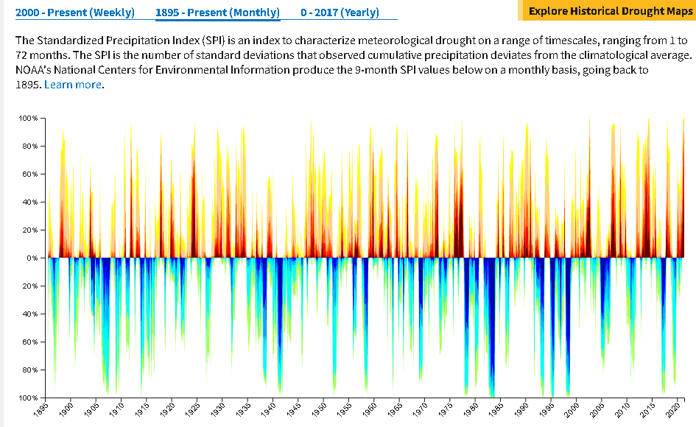
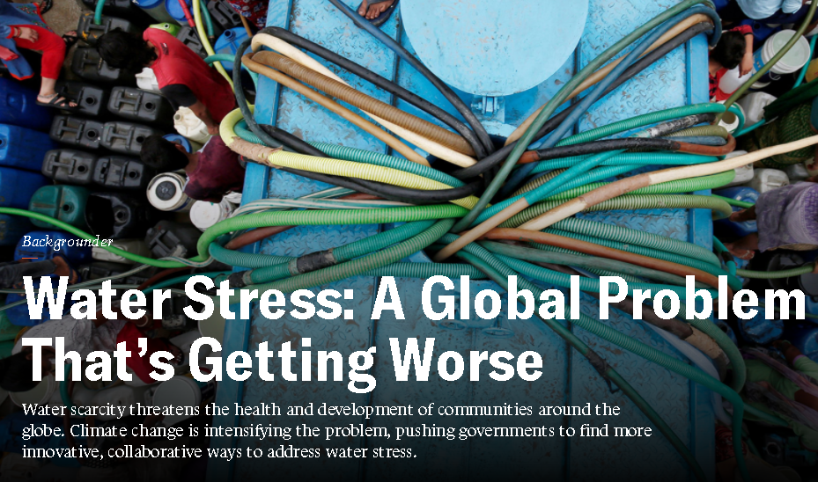
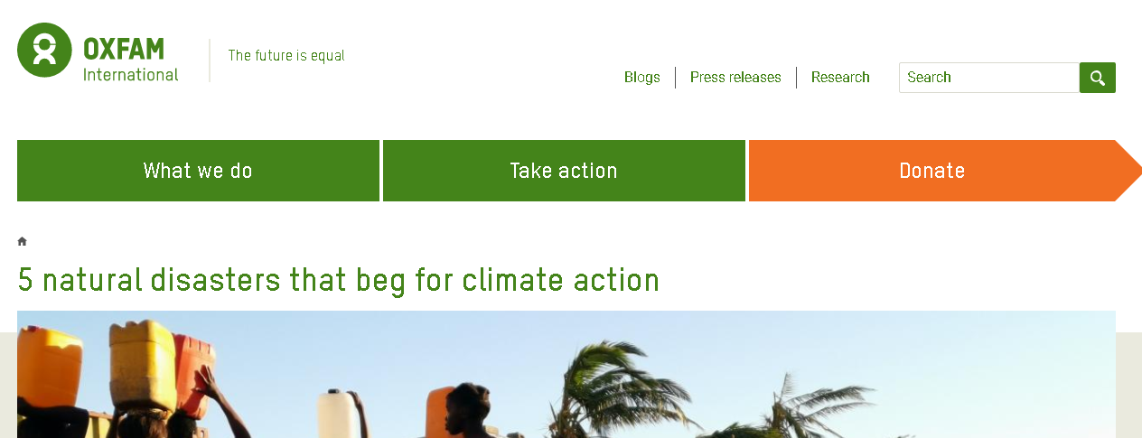
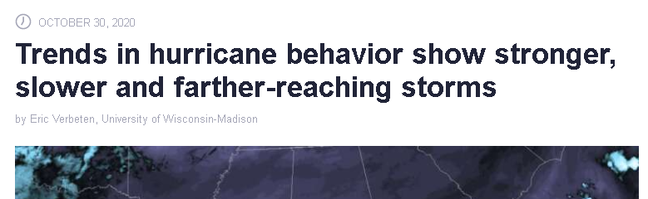
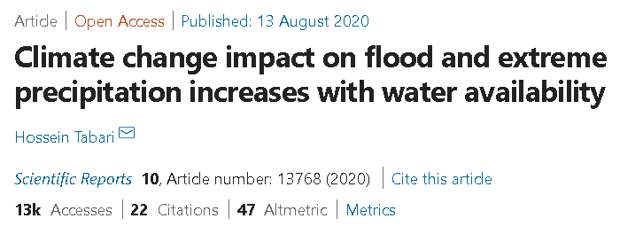
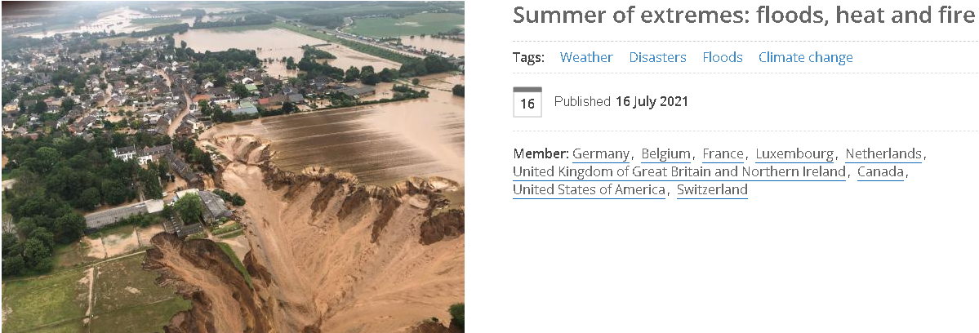
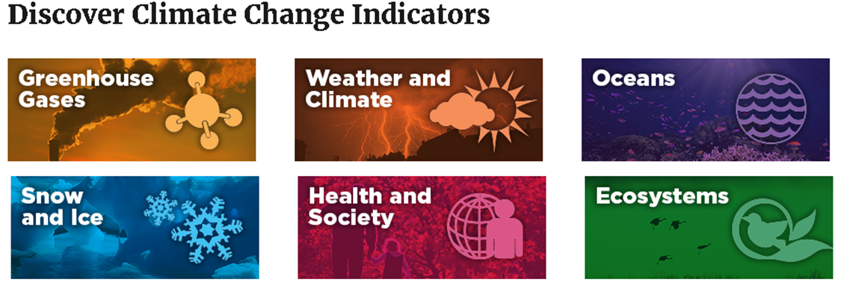
What is the problem? Climate change?
Notes:
Climate change impact on flood and extreme precipitation increases with water availability | Scientific Reports (nature.com): https://www.nature.com/articles/s41598-020-70816-2
Summer of extremes: floods, heat and fire | World Meteorological Organization (wmo.int): https://public.wmo.int/en/media/news/summer-of-extremes-floods-heat-and-fire
Water Stress: A Global Problem That’s Getting Worse | Council on Foreign Relations (cfr.org): https://www.cfr.org/backgrounder/water-stress-global-problem-thats-getting-worse
Climate Change Indicators in the United States | US EPA: https://www.epa.gov/climate-indicators

Slide 4

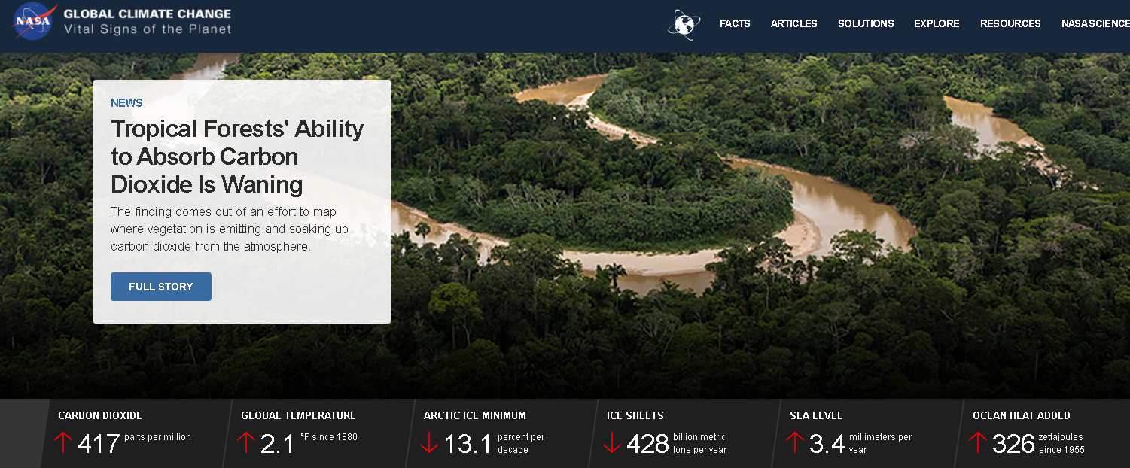
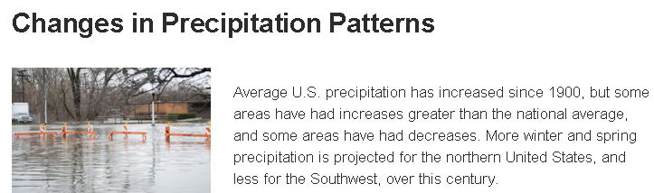
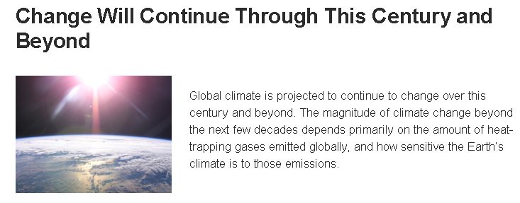
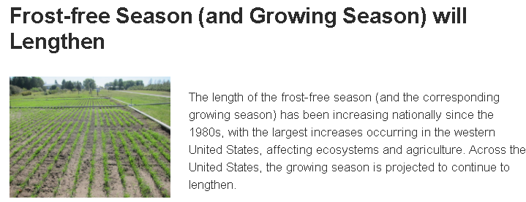
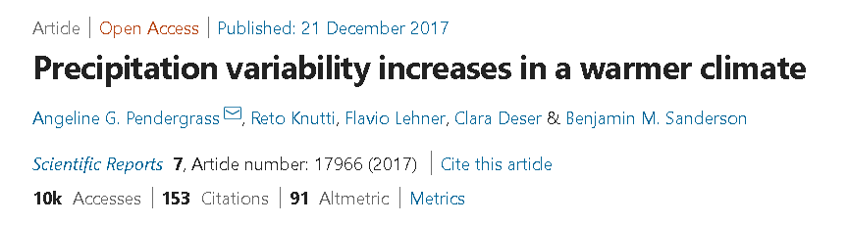
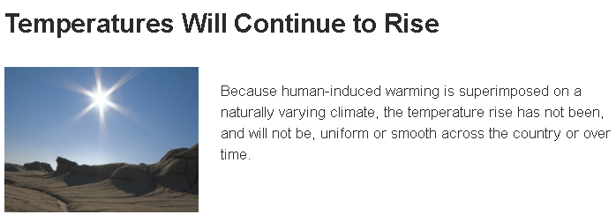
What is the orign? Human impacts?
climate.nasa.gov
climate.nasa.gov/effects

Slide 5
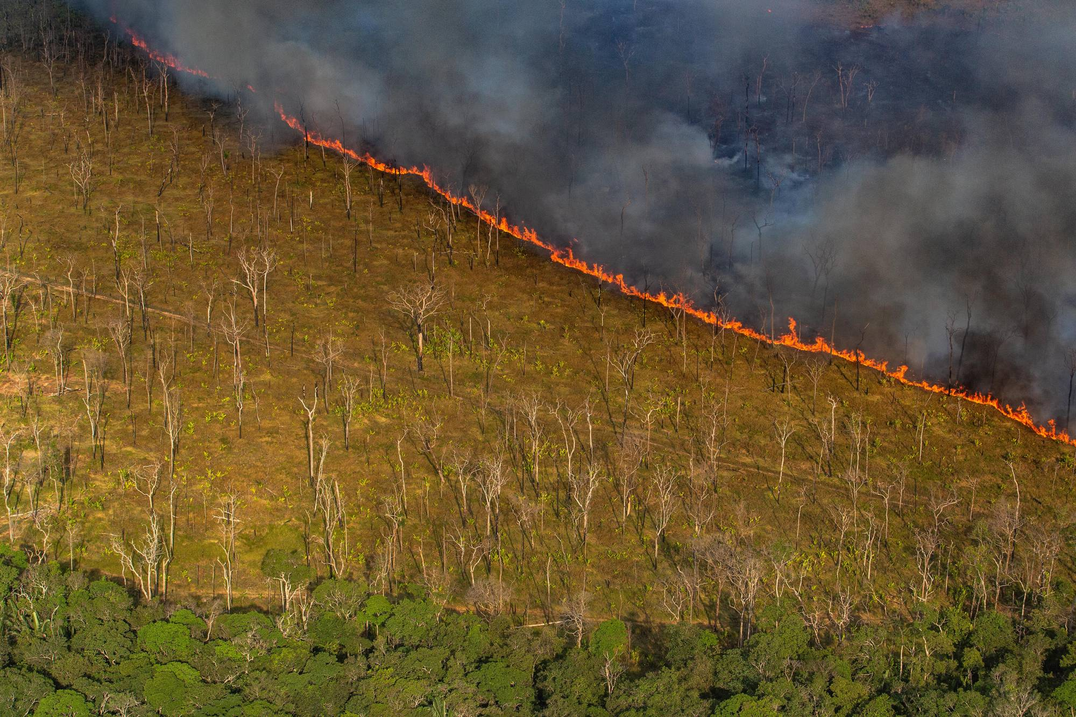
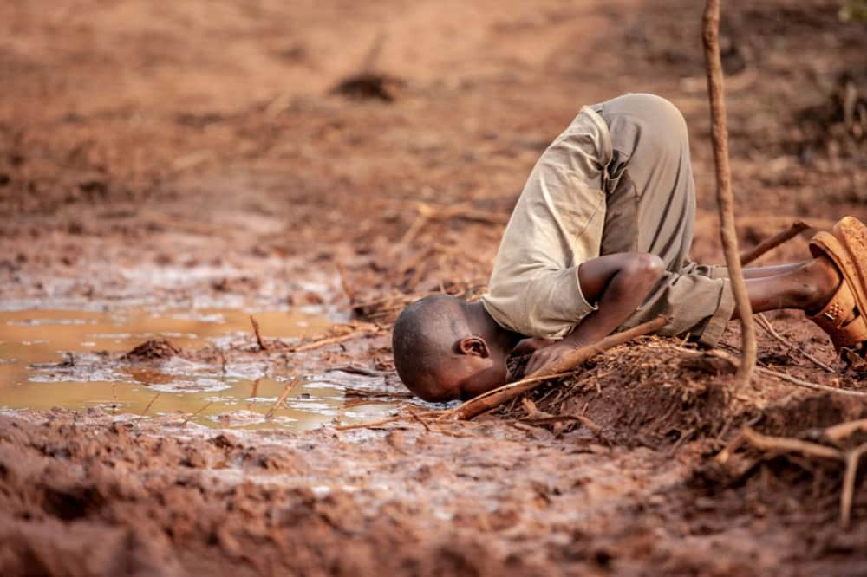
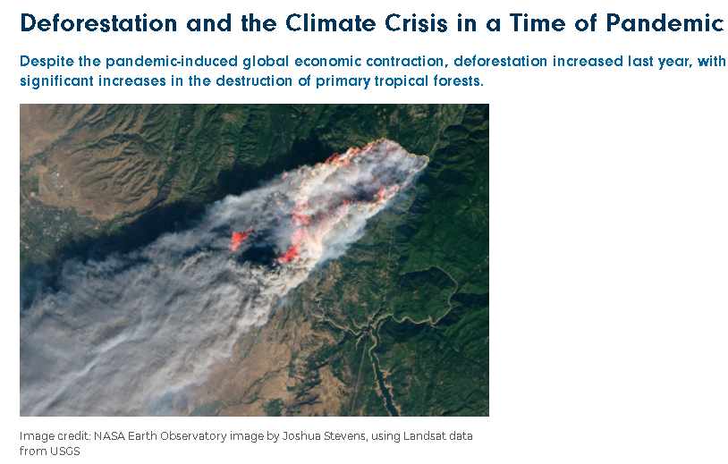
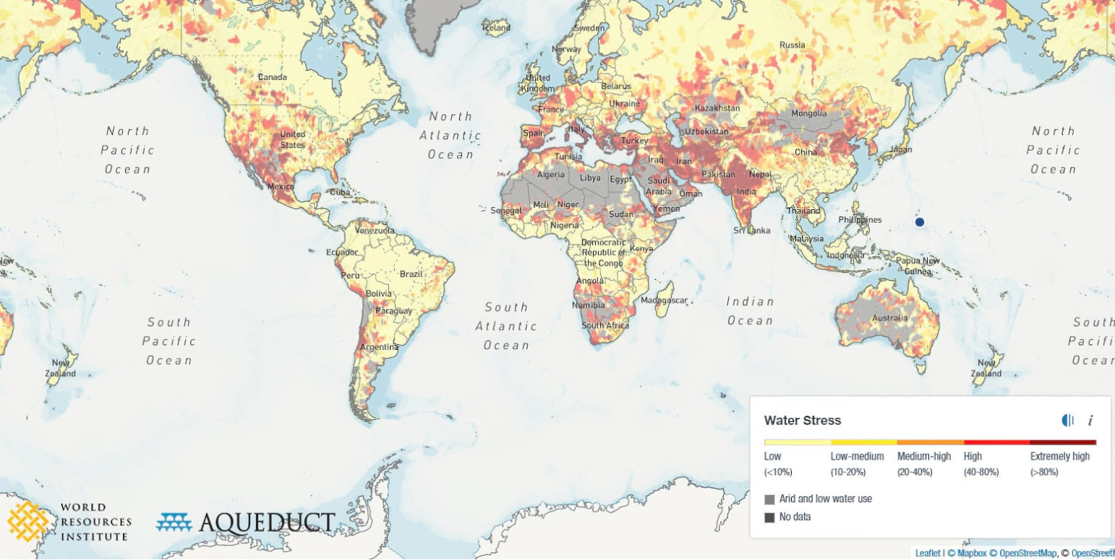
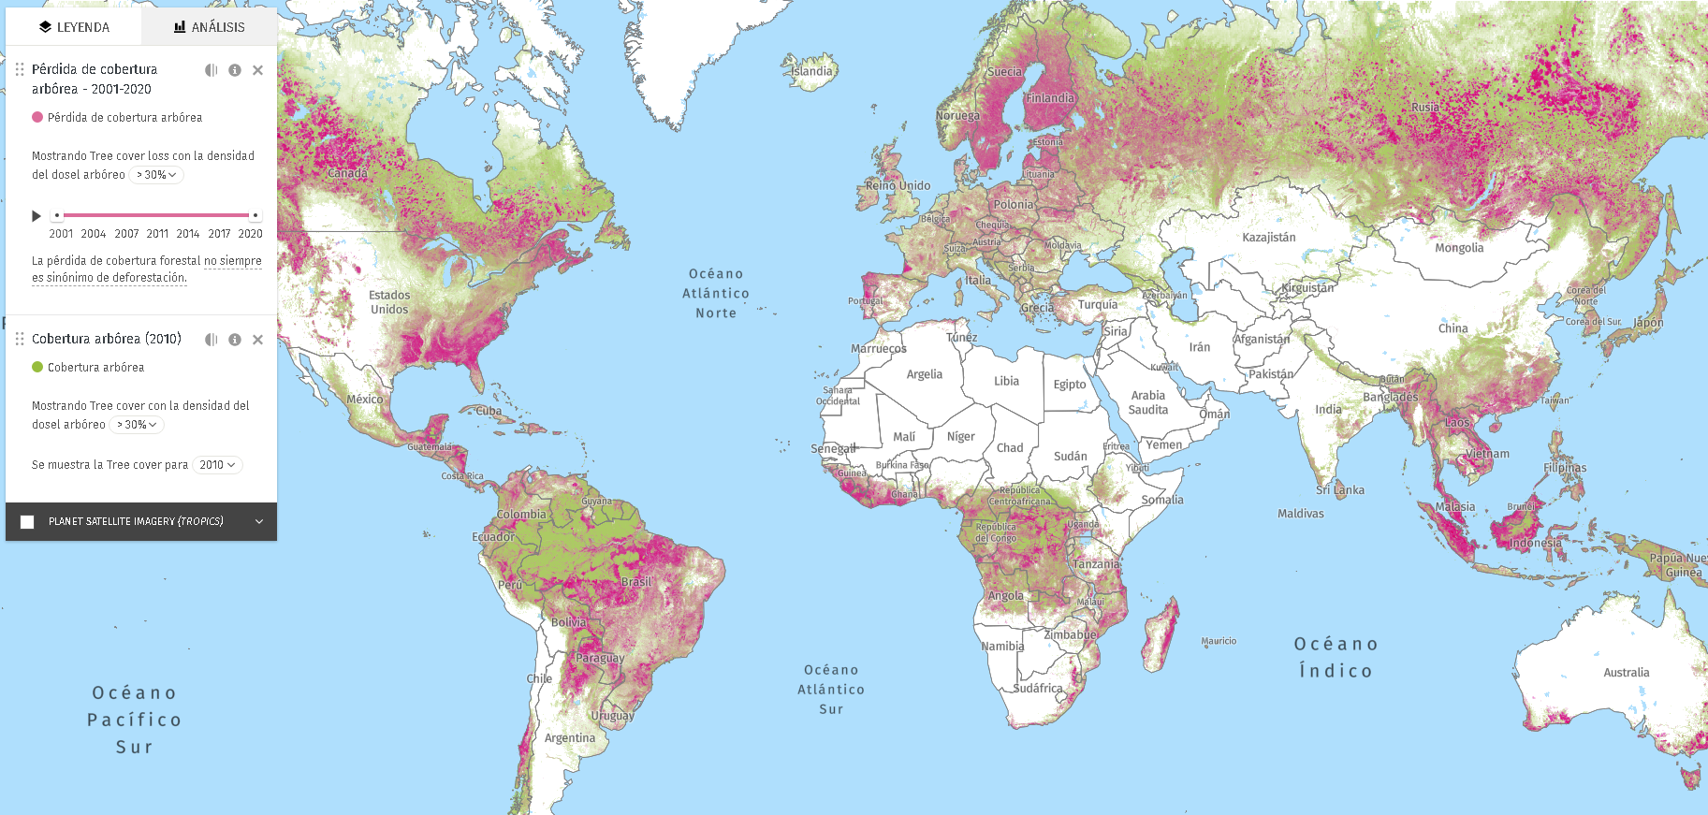
What is the problem?
URGENT!
Causes
IMPORTANT!
Water acces today
japantimes.co.jp
cc.gfamedia.org
wil.org
legal-planet.org
cc.gfamedia.org
globalforestwatch.org

Slide 6
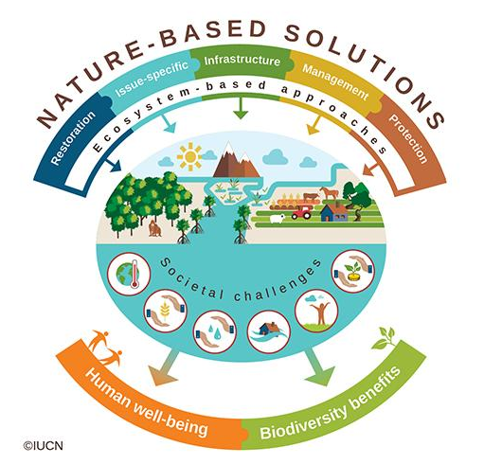
What is the problem?
URGENT!
Causes
IMPORTANT!
Water acces today
japantimes.co.jp
cc.gfamedia.org
Solution
Solution
wil.org
legal-planet.org
cc.gfamedia.org
globalforestwatch.org

Slide 7









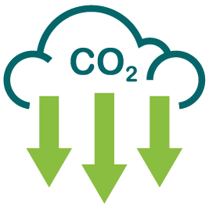




Nature Based Solutions (NBS)
-Wait, what (no investment)? Why?-
+
Clear
Trend:
Quality
Safe water
Drougths
Floods
-
+
Amount
Deforestation
Conservation
-
Sediments & pollutants
Beneficiaries:
Strategy: Avoid deforestation or restore forests
Execution: Single-time long- lasting effort
Costs: $0, or cheaper than delivery water bottles or build dams, drainages or channels

Slide 8




Goal
Provide a desktop/mobile platform for allow users to:
Find the closest river and basin geolocation in a map with one click in less than 5 seconds to solve urgent problem of water access
Estimate in less than 10 seconds the short-term historical trends of rainfall, temperature and forest cover to inform probability of water quality as inmediate problem
Identify historical deforestation inside a basin in about 15 seconds, and providing a map of current forest extent to inform decision makers where to conserve-restore and help mange the problem origin
Ayudar a usuarios (personas, empresas) a identificar la localización más cercana.
Soportar toma de decisiones de conservación y soluciones basadas en la naturaleza a través de datos históricos y espaciales

Slide 9



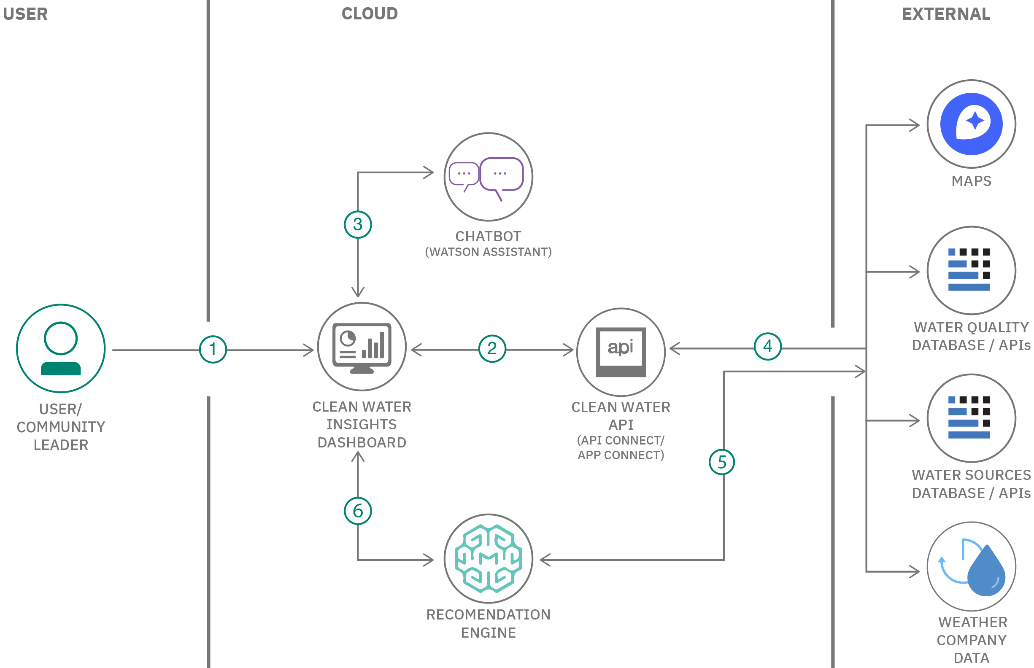

Architecture
IBM - Classic Vitual server
Ubuntu 20.04.2 LTS
+ NASA & other GIS sources
+ Watson assistant
+ Basins identification
+ Basemaps
+ Earth Engine - NASA API
+ R Plumber
+ Rivers extraction
+ Watson Studio
+ R Shiny
+ Deforestation maps
+ Tresholds and quantiles
+ R Core
+ Rainfall & temperatura maps

Slide 10
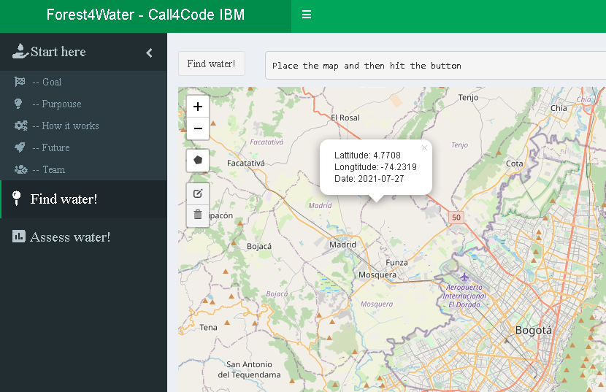
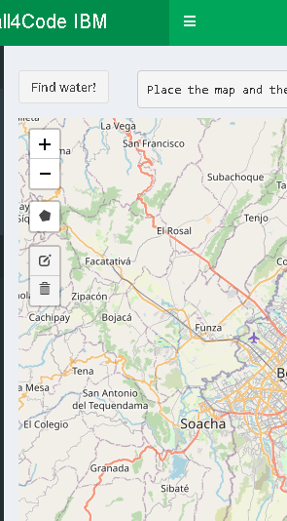
How it works?: 4 steps
0. Select a location arround the world (1 click)

Slide 11
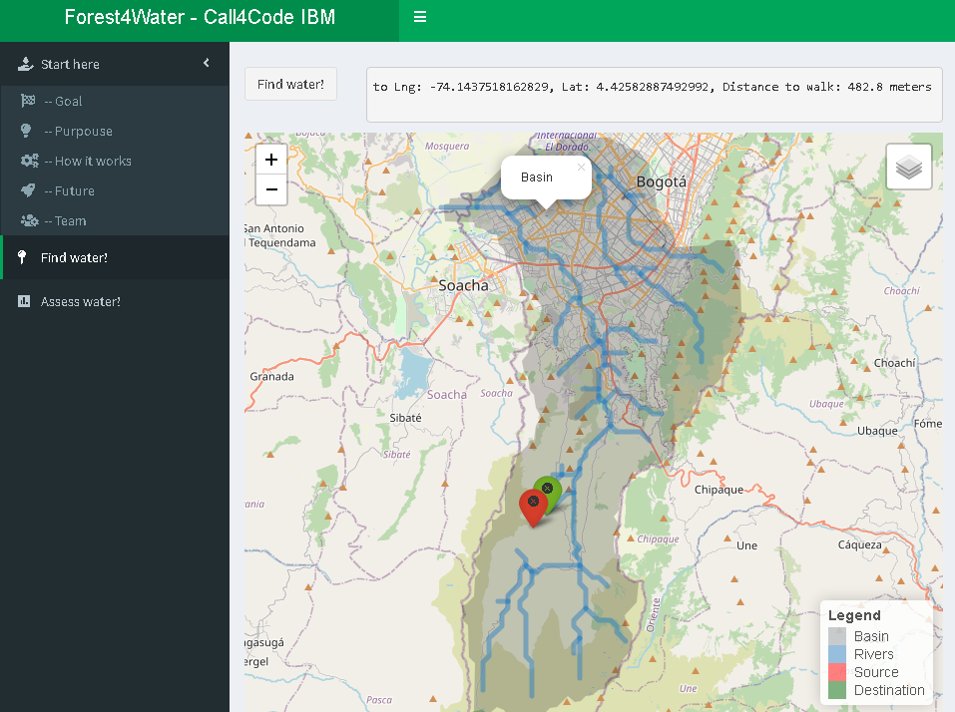
1. Get a basin and nearest river geolocation based in your coordinates: 1 click, 5 seconds

Slide 12
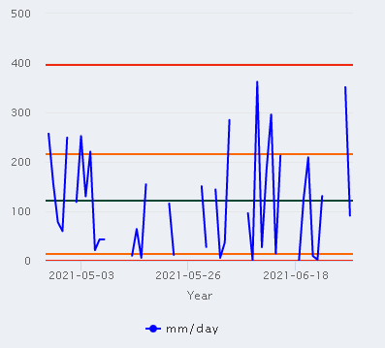
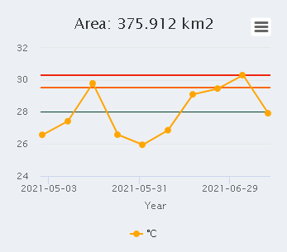
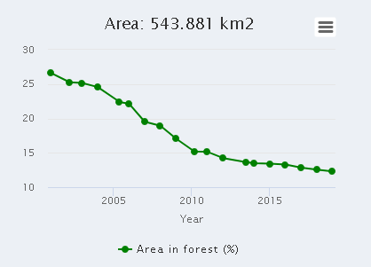
Lluvia (Corto plazo)
2. Get statistics, trends and water quality estimation based on recent history in your basin: 1 click, 10 seconds
Temperatura (Corto plazo)
Deforestación
(largo plazo)

Slide 13
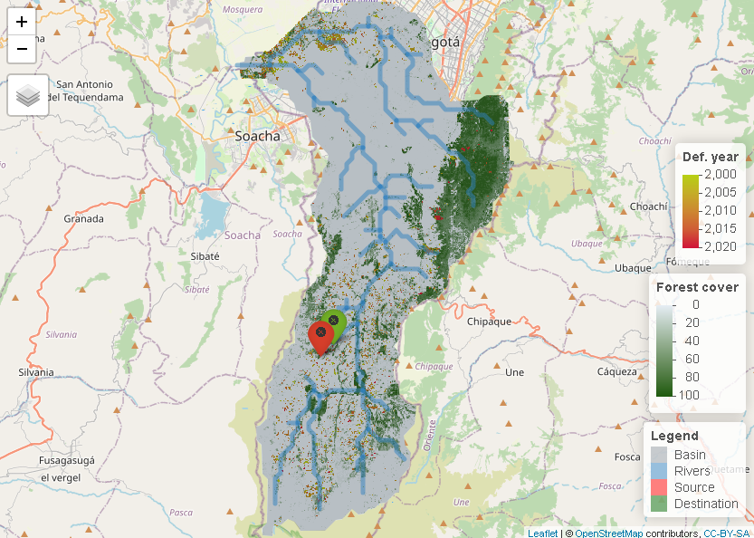
3. Get forest and deforestation maps to assess conservation and restoration activities in your basin: 1 click, 15 seconds

Slide 14
RoadMap
Uso
de
Librerías
Actually
Uso
de
Datasets
Prototipo de la Idea
Modelo de
Arquitectura en
IBM Cloud
5
Implementación
de
Chatbot
1
7
4
9
3
8
Creación
de
Plataforma
2
Análisis
de
Datos
10
Modelo
de
Negocio
6
Despliegue de
Plataforma
IBM Cloud
23/07/21
Uso de API’s

Slide 15
RoadMap
01/09/21
Actually
Asociación con Gobiernos e Instituciones
PWA Plataforma
Escalar Plataforma
13
Automatización
de procesos
Analíticos
17
11
15
16
Uso de más tecnologías de IBM Cloud
18
14
12
GPS Automático Usuario
Uso de Protocolo
HTTPS
Nuevos Datasets o API’s

Slide 16
RoadMap
Use
of
Libraries
Actually
Use
of
Datasets
Idea Prototype
IBM Cloud
Architecture
Model
5
Implementation
Chatbot
1
7
4
9
3
8
Building
Web Platform
2
Business Model
Data Analytics Processes
10
6
Platform
Deployment
23/07/21
Uso de API’s

Slide 17
RoadMap
01/09/21
Actually
Partnership
with
Governments
PWA Plataform
Scale
Plataform
13
Analytical
Process
Automation
17
11
15
16
Use more IBM Cloud Technologies
18
14
12
Automatic
GPS User
Use of HTTPS
Protocol
New Datasets o API’s

Slide 18











Gracias - Thanks - Obrigado
forest4water@gmail.com
Iván
González Ecologist
PhD Student – Ecoinformatics
Norther Arizona University (USA)
Ivan.Gonzalez@nau.edu
@gonzalezivan90
Fernando
Maldonado Computer systems eng.
Esp. Student – High performance distribuited processing
Veracruz technologic institute (Mex)
l15020799@veracruz.tecnm.mx
@ferjml97
Caleb Hernandez
Computer systems eng
Daniel
López Computer systems eng.
Msc. Student –Information eng.
Andes University (COL)
d.lopezl@uniandes.edu.co
@danflop

Slide 19
Some links
Climate change impact on flood and extreme precipitation increases with water availability | Scientific Reports (nature.com): https://www.nature.com/articles/s41598-020-70816-2
Summer of extremes: floods, heat and fire | World Meteorological Organization (wmo.int): https://public.wmo.int/en/media/news/summer-of-extremes-floods-heat-and-fire
Water Stress: A Global Problem That’s Getting Worse | Council on Foreign Relations (cfr.org): https://www.cfr.org/backgrounder/water-stress-global-problem-thats-getting-worse
Climate Change Indicators in the United States | US EPA: https://www.epa.gov/climate-indicators
Water Stress: The Unspoken Global Crisis - Gospel for Asia (gfa.org):
https://www.gfa.org/special-report/dying-of-thirst-global-water-crisis/
Most Important Conversation for Nature - WILD Foundation
Most Important Conversation for Nature - WILD Foundation

